Slide 1
Foothill High School
National Honor Society

Slide 2
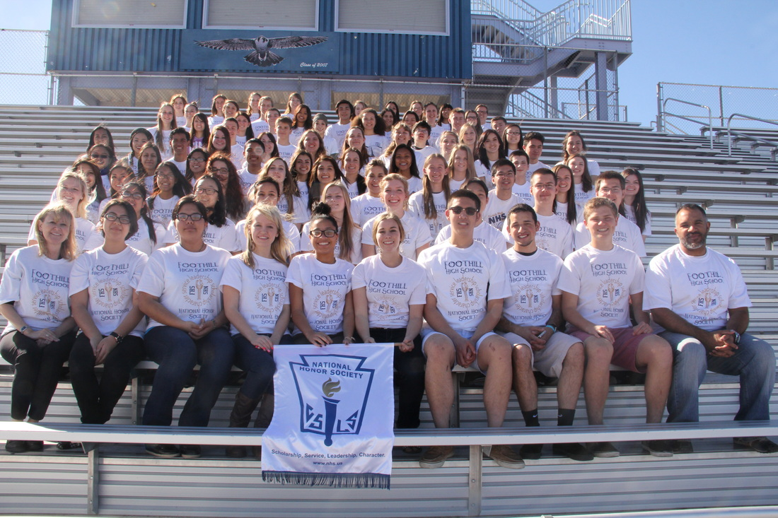
National Honor Society
4 PILLARS OF NHS
Character
Scholarship
Leadership
Service

Slide 3
President
Charlotte Wall
Vice President
Gloria Nam

Slide 4
Secretary
Kaylee Torres

Slide 5
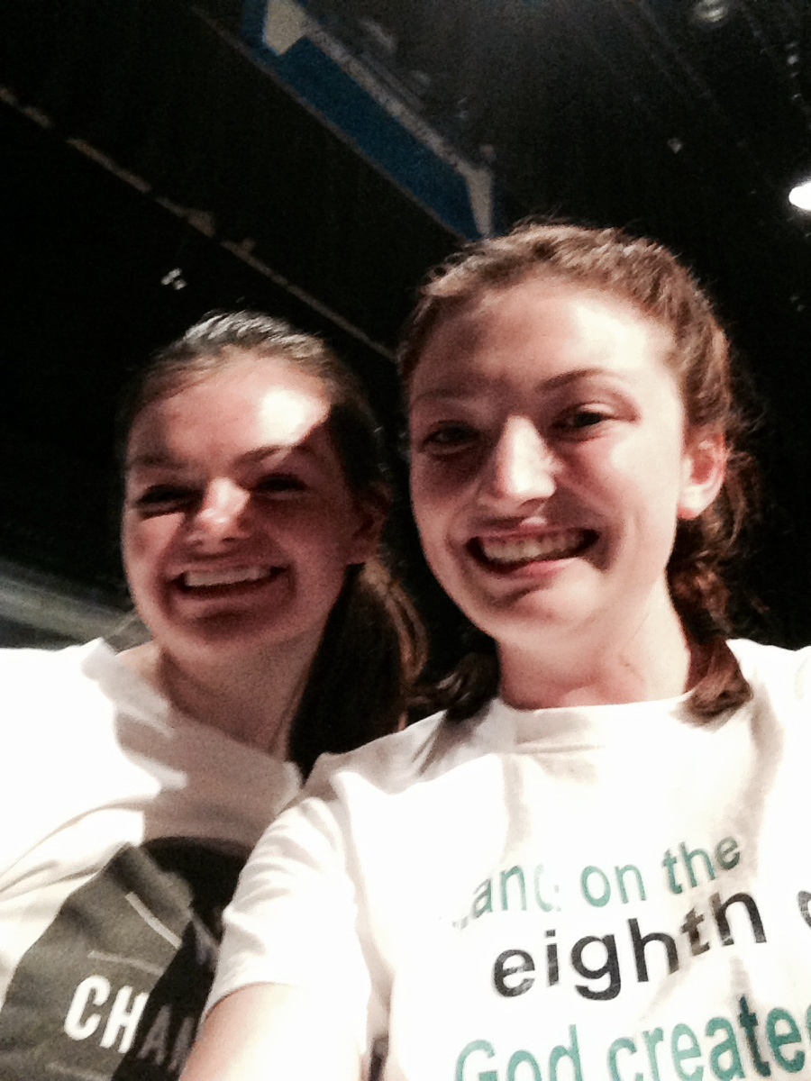
Historians
Bailie Rudd
Madelyn Pendleton

Slide 6
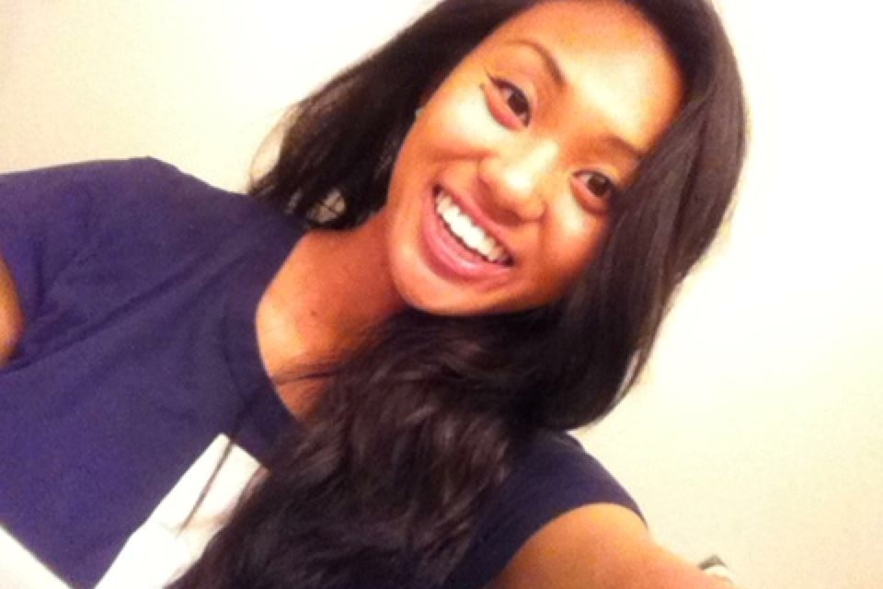
Service Officer
Myriah Epino

Slide 7
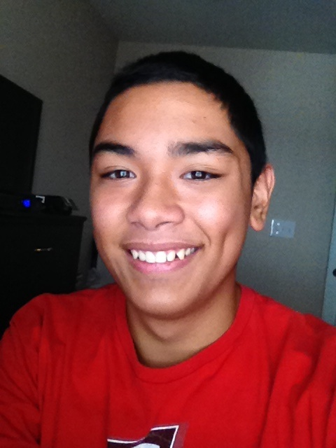
Service Officer
Alezar Gorewich

Slide 8
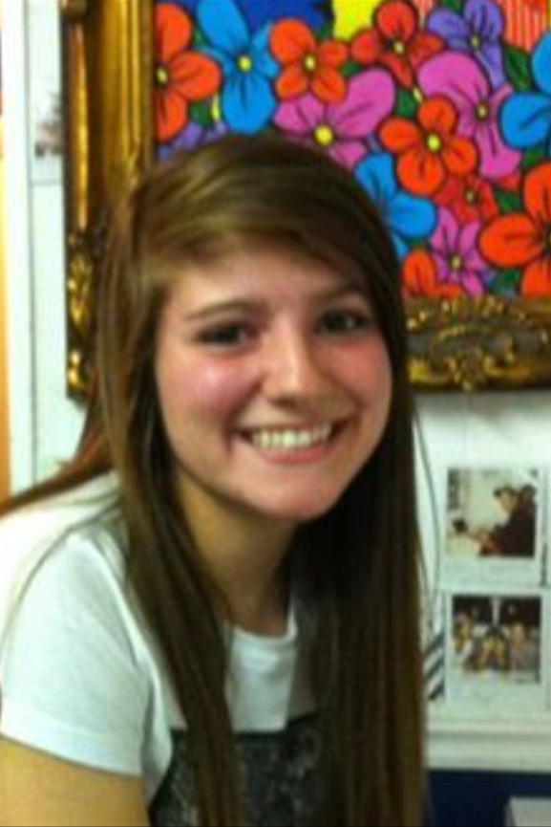
Leadership Team
Rachel Kole

Slide 9
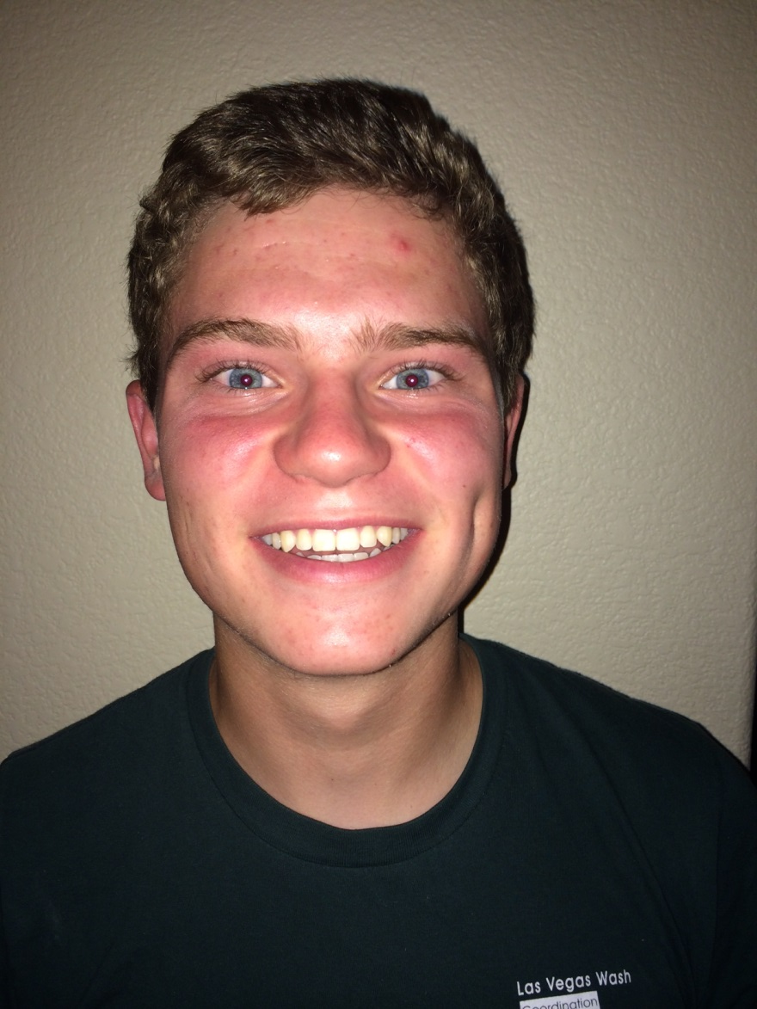
Leadership Team
Cameron Noorda

Slide 10
Leadership Team
Sammie Vasquez

Slide 11
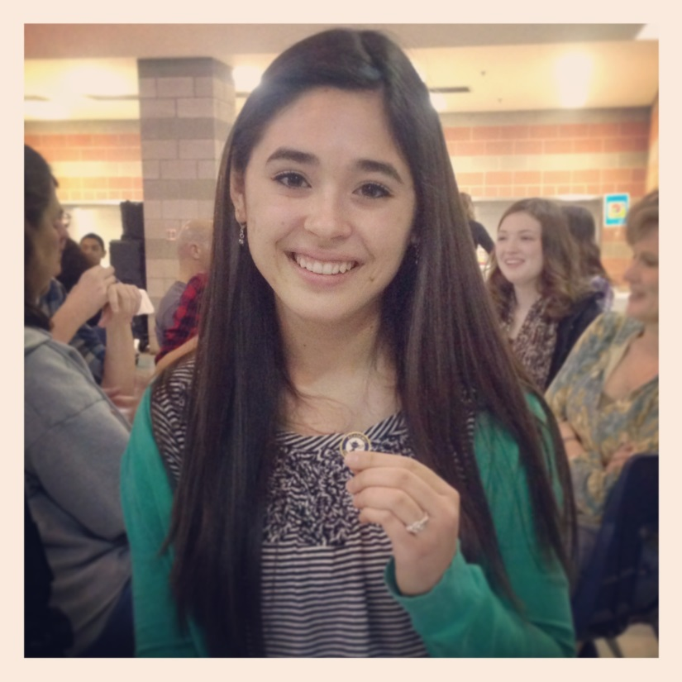
Leadership Team
Marissa
Panchal

Slide 12
How will this benefit you?
What do we do?
Community service
Volunteer at
local events
Serve the needy
Help the homeless
Make a positive impact in the world.
Great for college applications
Improve your chance of getting a scholarship

Slide 13
NHS requirements
10th, 11th or 12th graders only
Maintain a 3.3 GPA (un-weighted)
Enroll in at least one Honors level, Dual Credit, or A.P. course
14 service hours each quarter (7 Club and 7 Individual)
3 quarters = 42 hours minimum

Slide 14
Individual hours
7 hours you do on your own:
Volunteering at a hospital, nursing home, church, tutoring, helping someone move, yardwork for a neighbor, swim lessons, dog walking, etc. (DON’T ACCEPT MONEY)
A signature is required from the person or organization rep. you assisted.

Slide 15
Rules for individual hours:
Any activity where you get paid does NOT count for individual hours.
Babysitting does not count for individual hours (even if you don’t get paid).
Volunteering means that you are doing something to help your community. You may not earn more than three individual hours for any one service opportunity. It is important you spread yourself around the community.

Slide 16
Club hours
NHS sponsored events – an officer or advisor must sign off on hours.
Larger group activities
Wear your official NHS shirt
Attendance at meetings is essential to acquire information on these events.
Sign up via constantcontact.com

Slide 17
Upcoming events
Clean football stands after games
Teddy Bear Run 5K- volunteer
Run or Dye 5K- volunteer
Book cleanings- in October
Relay for Life 5K
Trail clean up
Check the calendar online

Slide 18
Hour logs
Turn in by the deadline (end of quarter).
Every day your hour log is late, you must complete one additional club hour of service.
If not turned in within (5 school days) of due date, you are removed from Foothill’s National Honor Society.
Follow the timelines and expectations of service opportunities and hour sheet due dates.

Slide 19
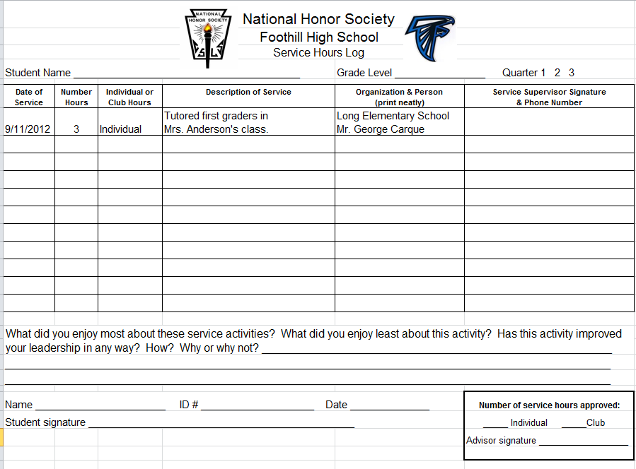
Fill this out for the person who is signing your log.

Slide 20
Dues
Dues are $20!
$10 for the shirt which is to be worn at all club sponsored activities. No shirt – no participation!
$10 fee to purchase supplies.
Dues paid to the school banker or on the Foothill online store.

Slide 21
Important websites
constantcontact.com
NHS service information, register for events.
foothillnhs.weebly.com
Calendars, forms, event details
teacherweb.com
Sign up for text messages

Slide 22
On website: foothillnhs.weebly.com click on calendar

Slide 24
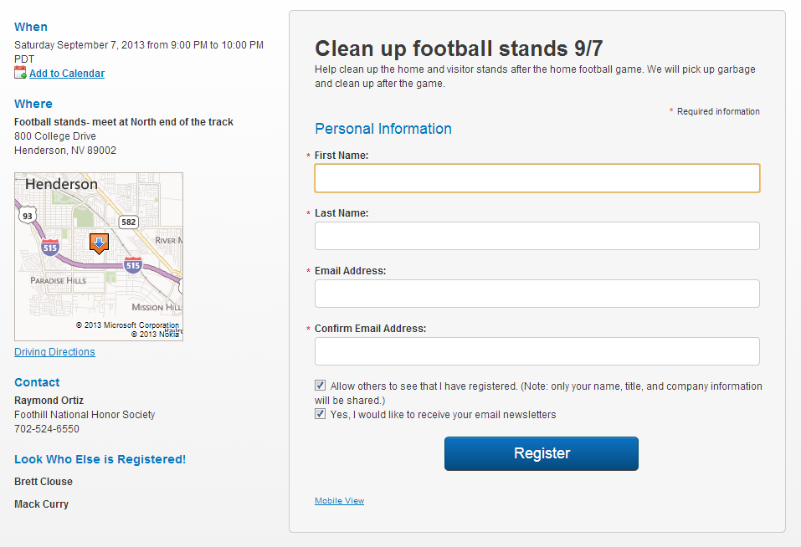

Slide 25
Get the texts
Register for the texting and/or email program, and check this information on a consistent basis.
If there are changes to service opportunities, cancellations, or last minute opportunities, we need to be able to contact you quickly.
The best way to do this is via the teacherweb.com texting program.

Slide 26
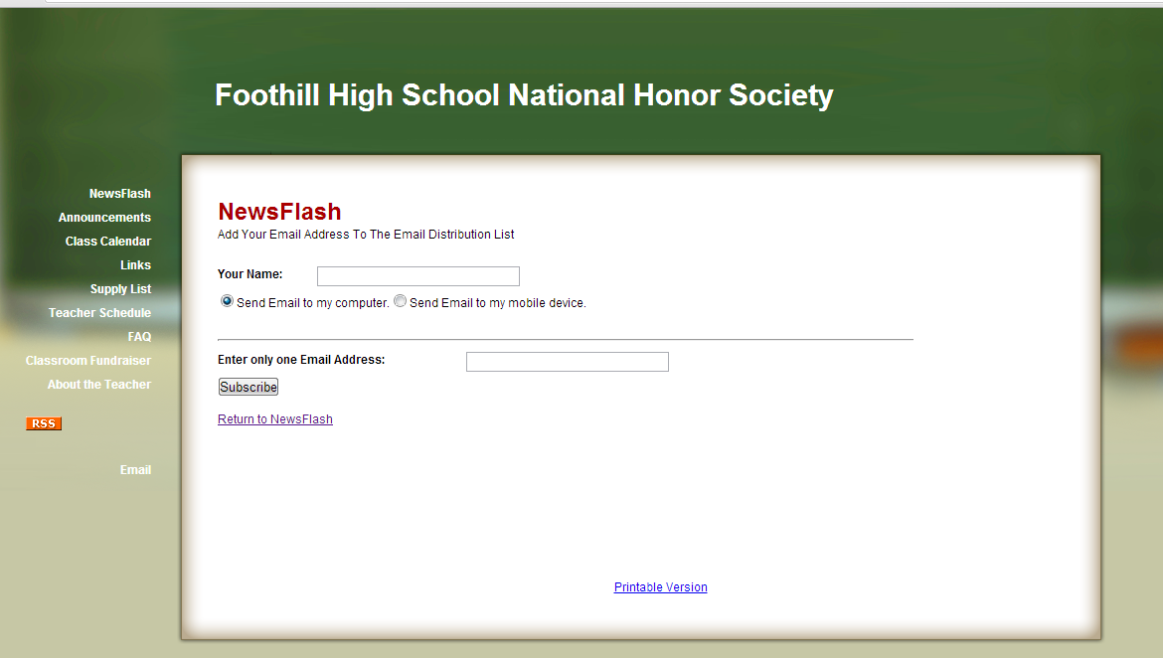
teacherweb.com
Email messages

Slide 27
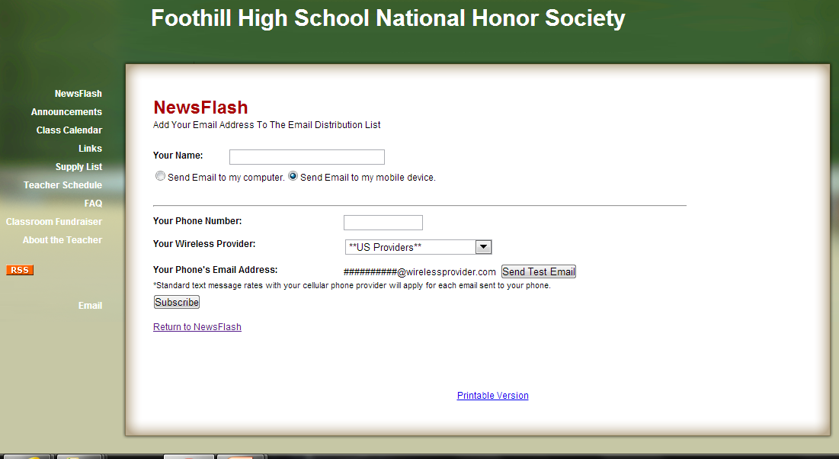
Text messages

Slide 28
Cancellations
If you sign up for an event, you are responsible to go to it. Once jobs are filled, no one else may sign up for the job.
If you need to cancel, send Gloria Nam a DETAILED text message which includes:
Your name
Date of event
Name of event

Slide 29
Are you a busy student? Don’t think you can do the hours? Check your closets and drawers!

Slide 30
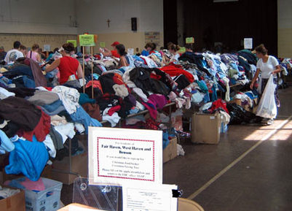
Donate used clothes to help homeless teens.
Check the website for details.
SELECT ANY ONE OF THE FOLLOWING FOR 1 HOUR:
3 PAIRS OF JEANS/PANTS
3 T-SHIRTS/SHIRTS
2 SWEATSHIRTS
GIFT CARD TO WALMART, TARGET, PAYLESS SHOES (MIN. $15)
1 COAT

Slide 31
Vote for the shirt online!

Slide 32
Shirt design- hoodies available, too.
Wear the shirt at all club-sponsored events

Slide 45
Log on to the website and vote for the NHS shirt before midnight on Friday.
Pay your dues, get your shirt when they arrive.
Wear it to all events.

Slide 46
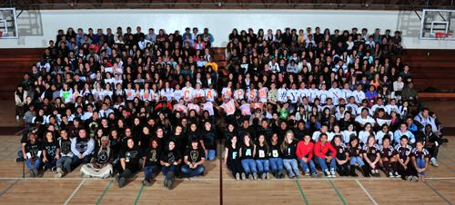
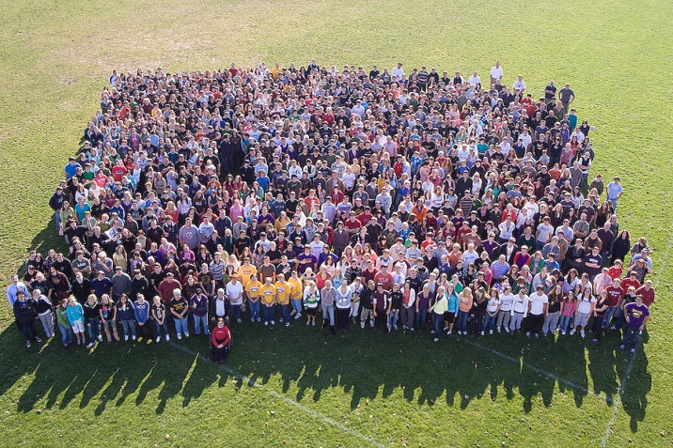
Yearbook Group Photo
October 9th
Wear your shirt!
Seniors in the front, 3rd year members in the front of the front!

Slide 47
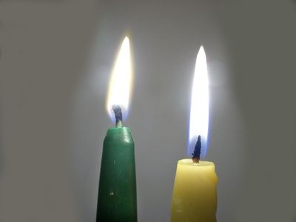
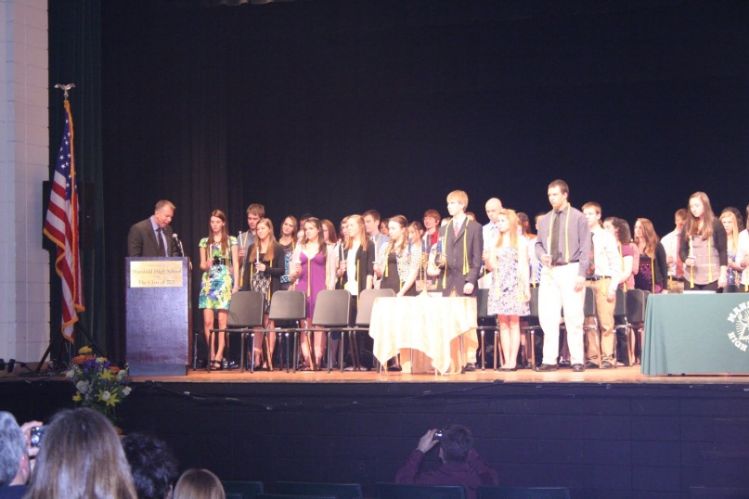
Induction is in April or May. You must complete a min. of 42 hours to be inducted. No exceptions!

Slide 48
Think you have what it takes?
Character
Scholarship
Leadership
Service
Join NHS and help make the world a better place!

